Slide 1
Reinforcement Learning for Personalized Digital Well-Being
Presented by
Kondaveeti Tejaswi
School of Data Science
IISER Thiruvananthapuram

Slide 2
Introduction
Impact of Social Media
Social Media: Usage Patterns
Positive and Negative Effects
Survey Analytics
RL for betterment of Mental Health

Slide 3
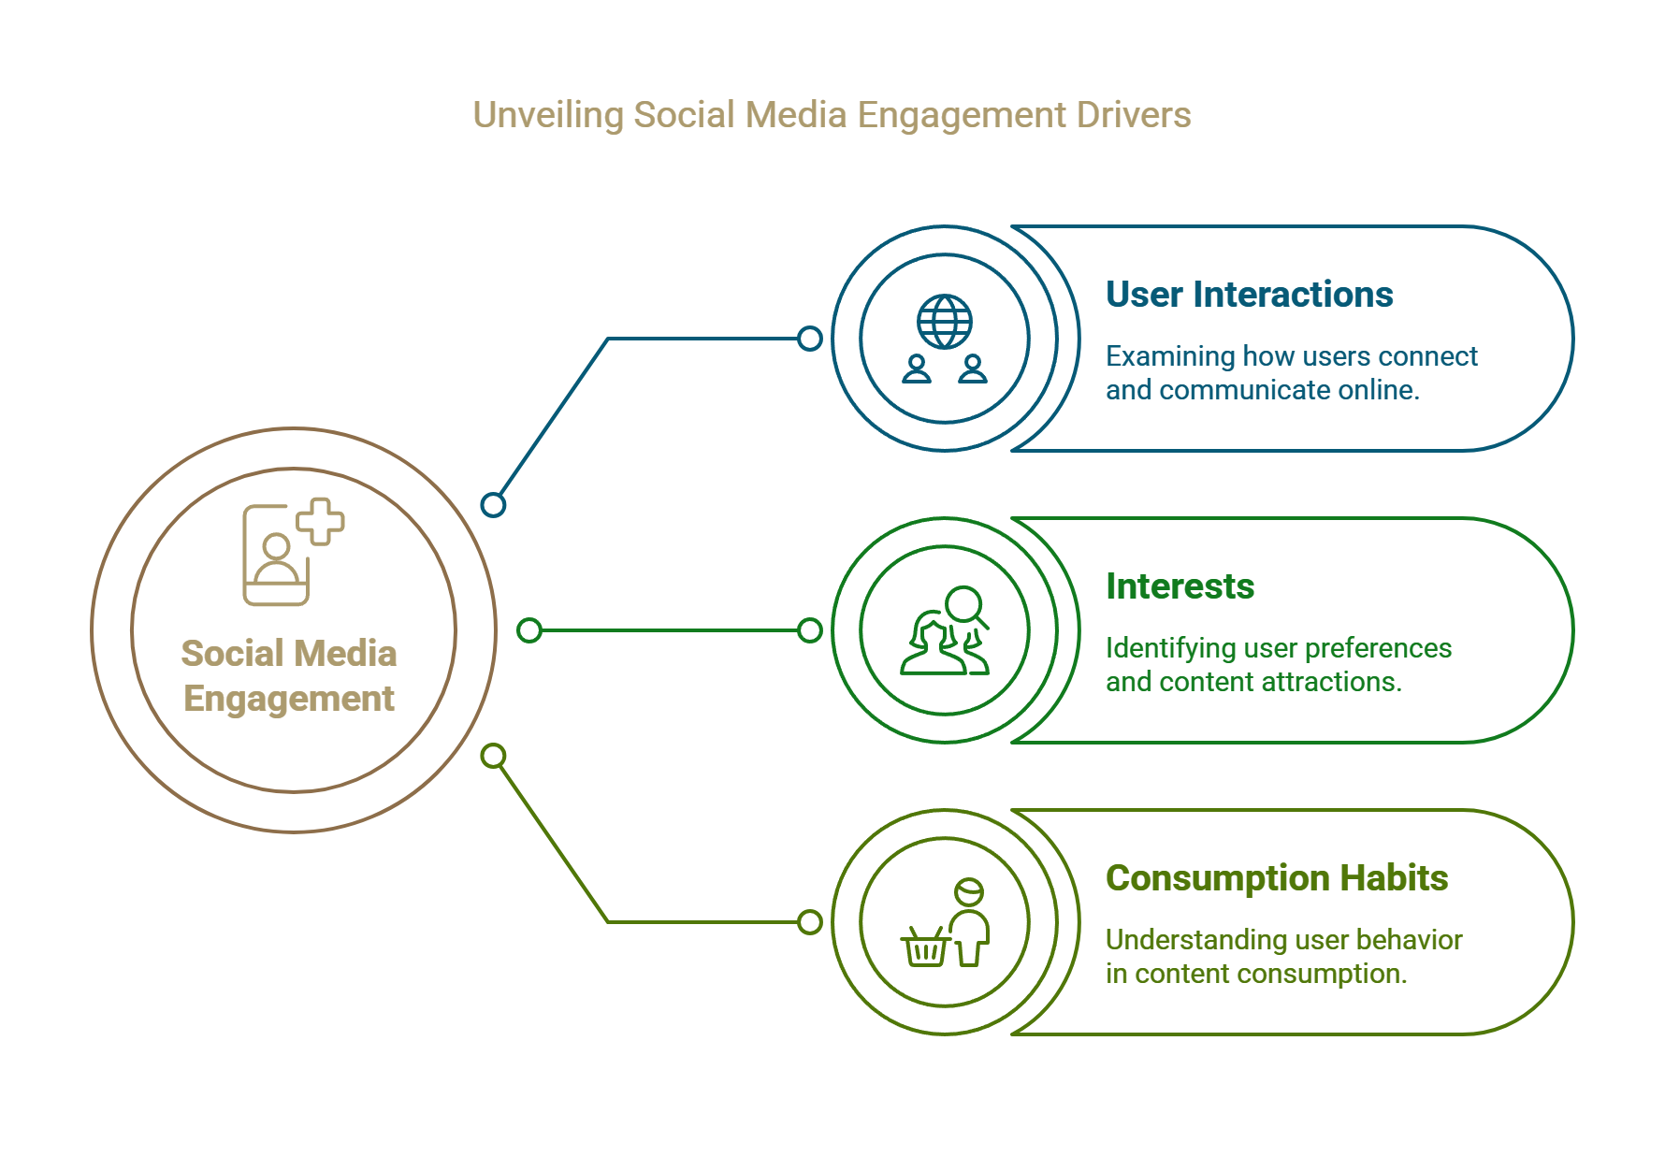

Slide 4
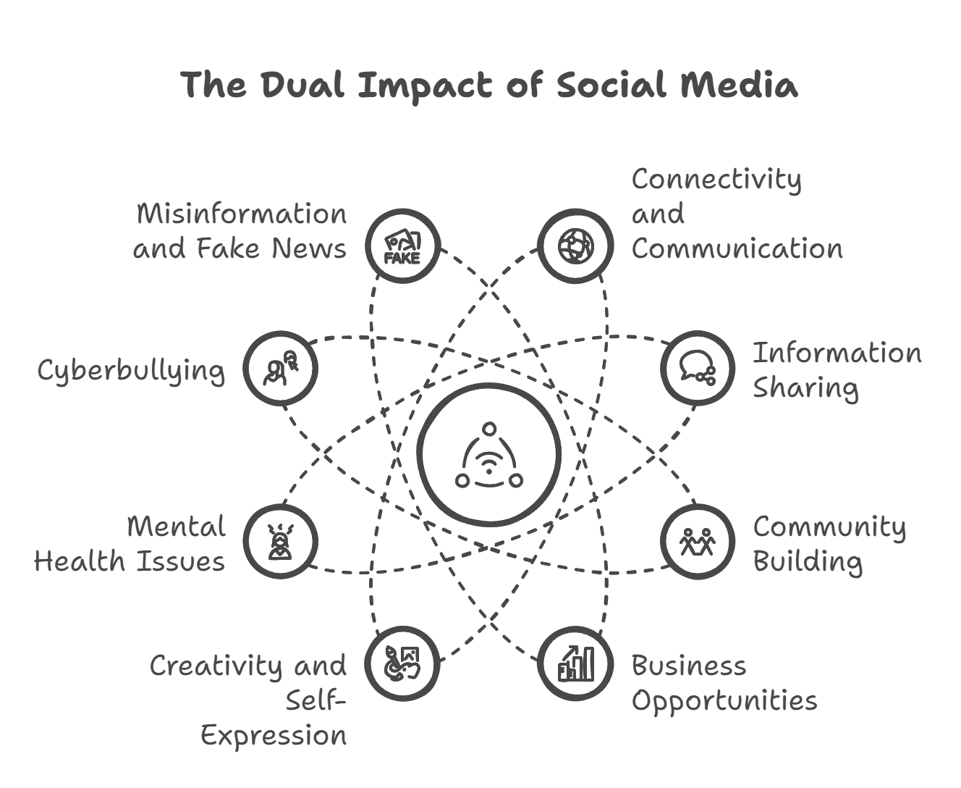

Slide 5
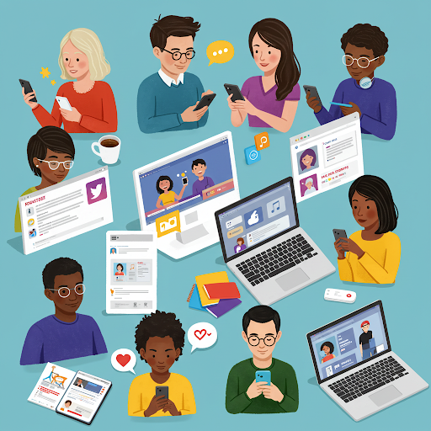
Social Media Usage Patterns
On average: 2-4 hours of Social media Usage
The most popular platforms are completely based on entertainment
Reasons for usage:
Entertainment – 70%
Socializing – 50%
Education – 30 %
Increased late-night usage

Slide 6
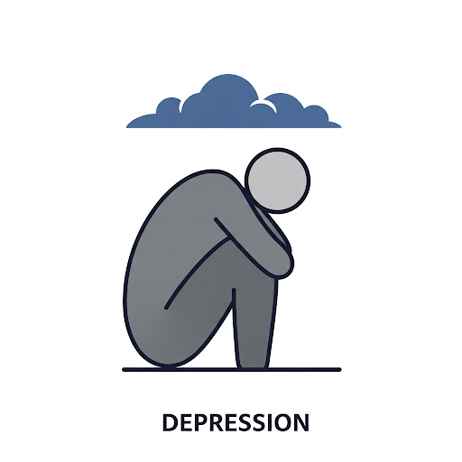
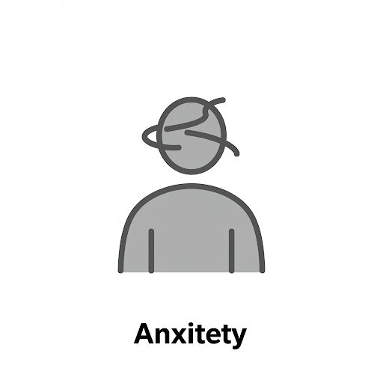
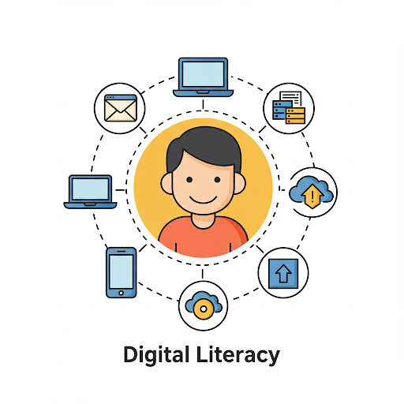


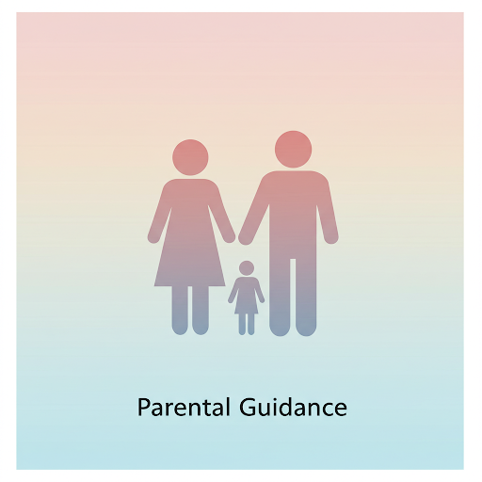
ANXIETY
LOW SELF-ESTEEM

Slide 7
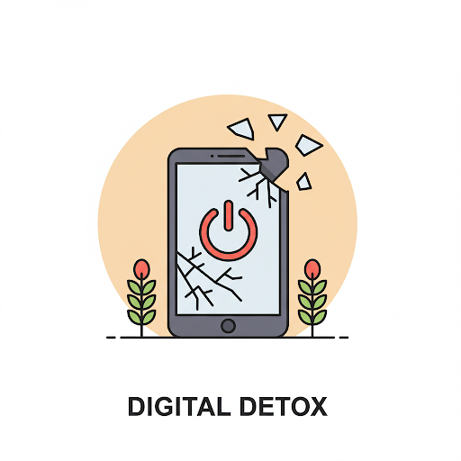
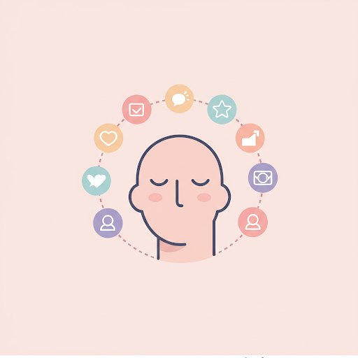

MINDFUL SOCIAL MEDIA USAGE
AWARENESS

Slide 8
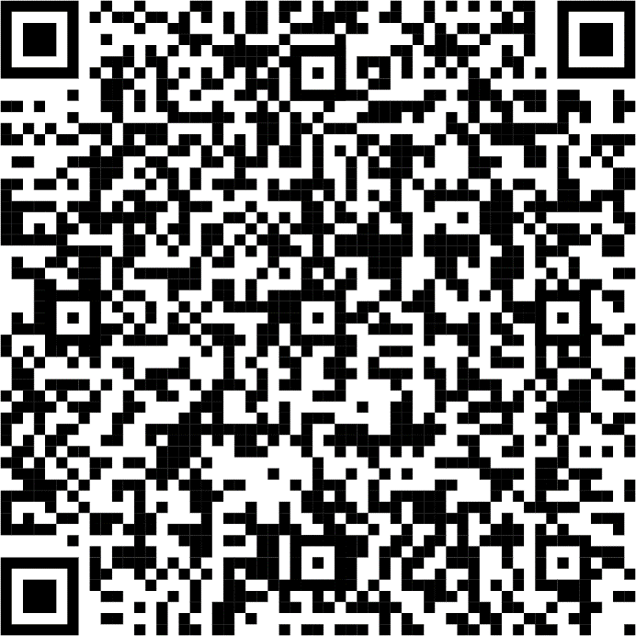
Survey
Kindly Scan and participate in the Survey
Demographics and Background
Social Media usage patterns
Psychological and Emotional impact
Behavioural Effects
Social Interactions
Positive and Negative Effects
Link: Survey: Affect of Social media on Teenagers and Young Adults

Slide 9
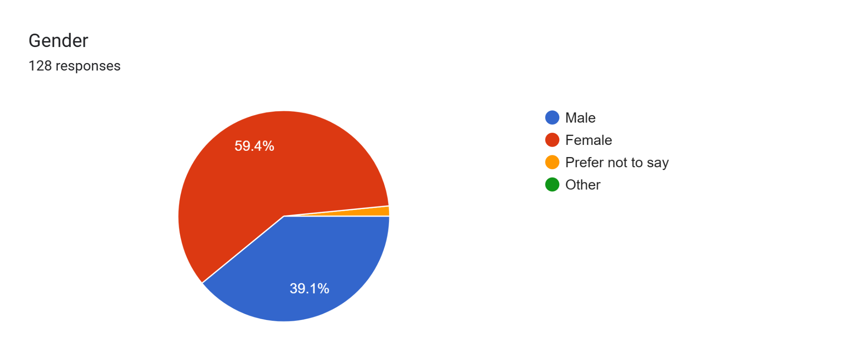
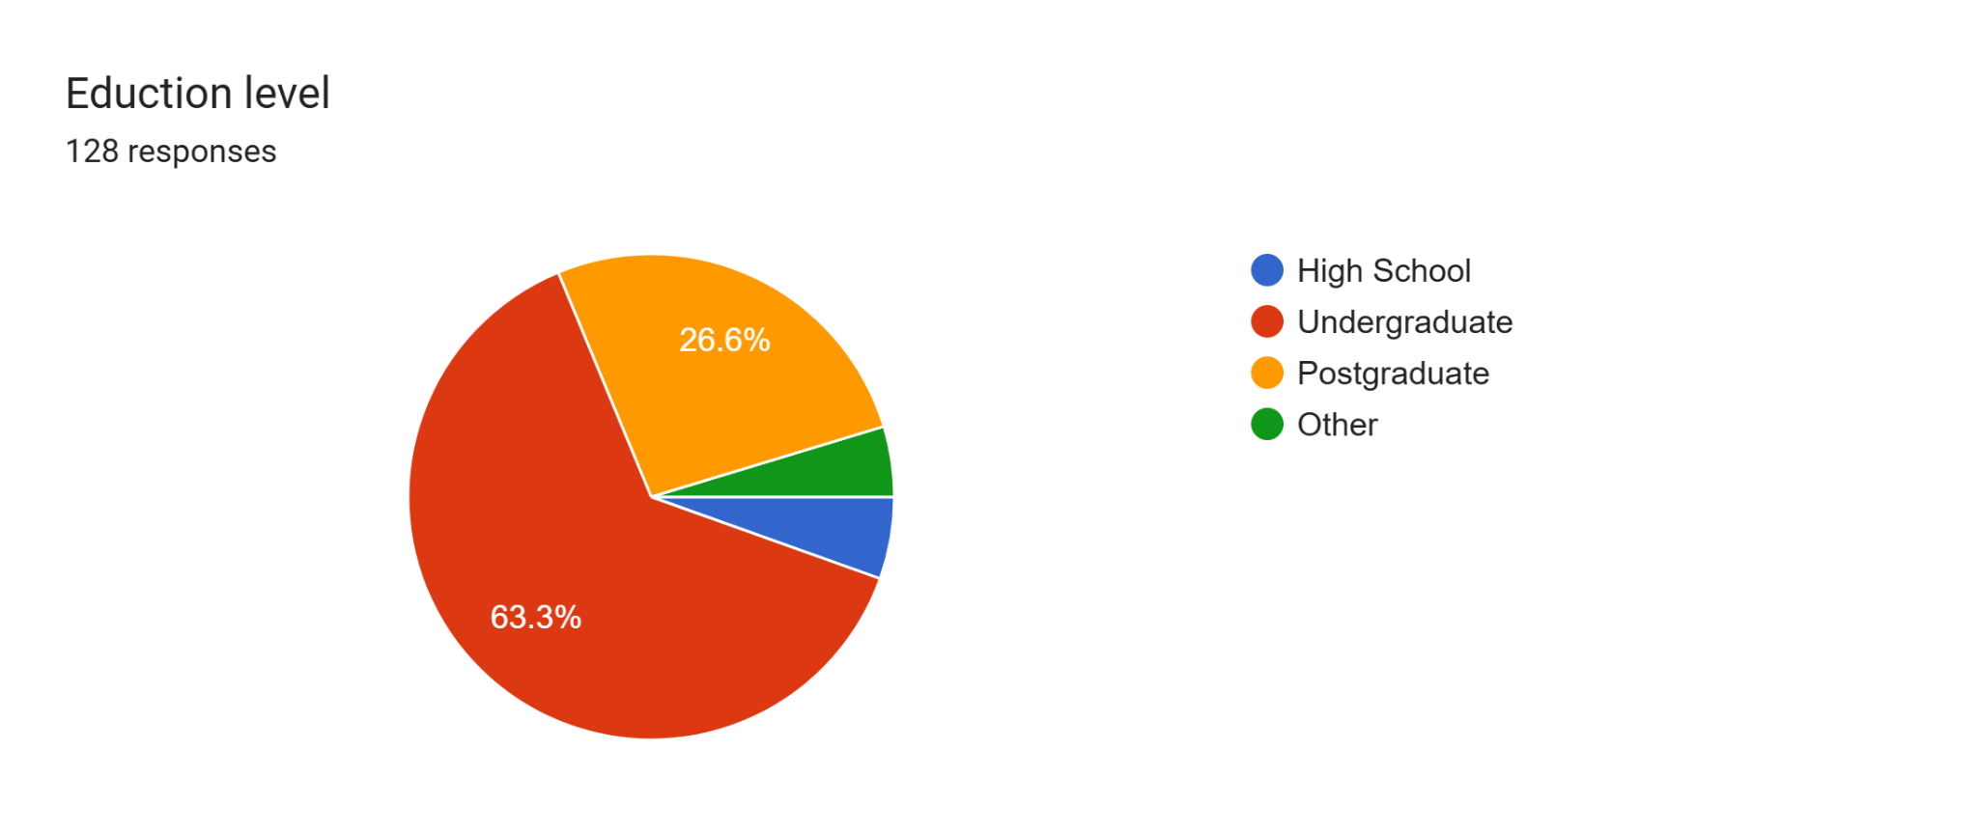
Survey Results
Responses from 128 individuals.
Privacy maintained for all the individuals
Data collected from people in the age group 13 to 25

Slide 10
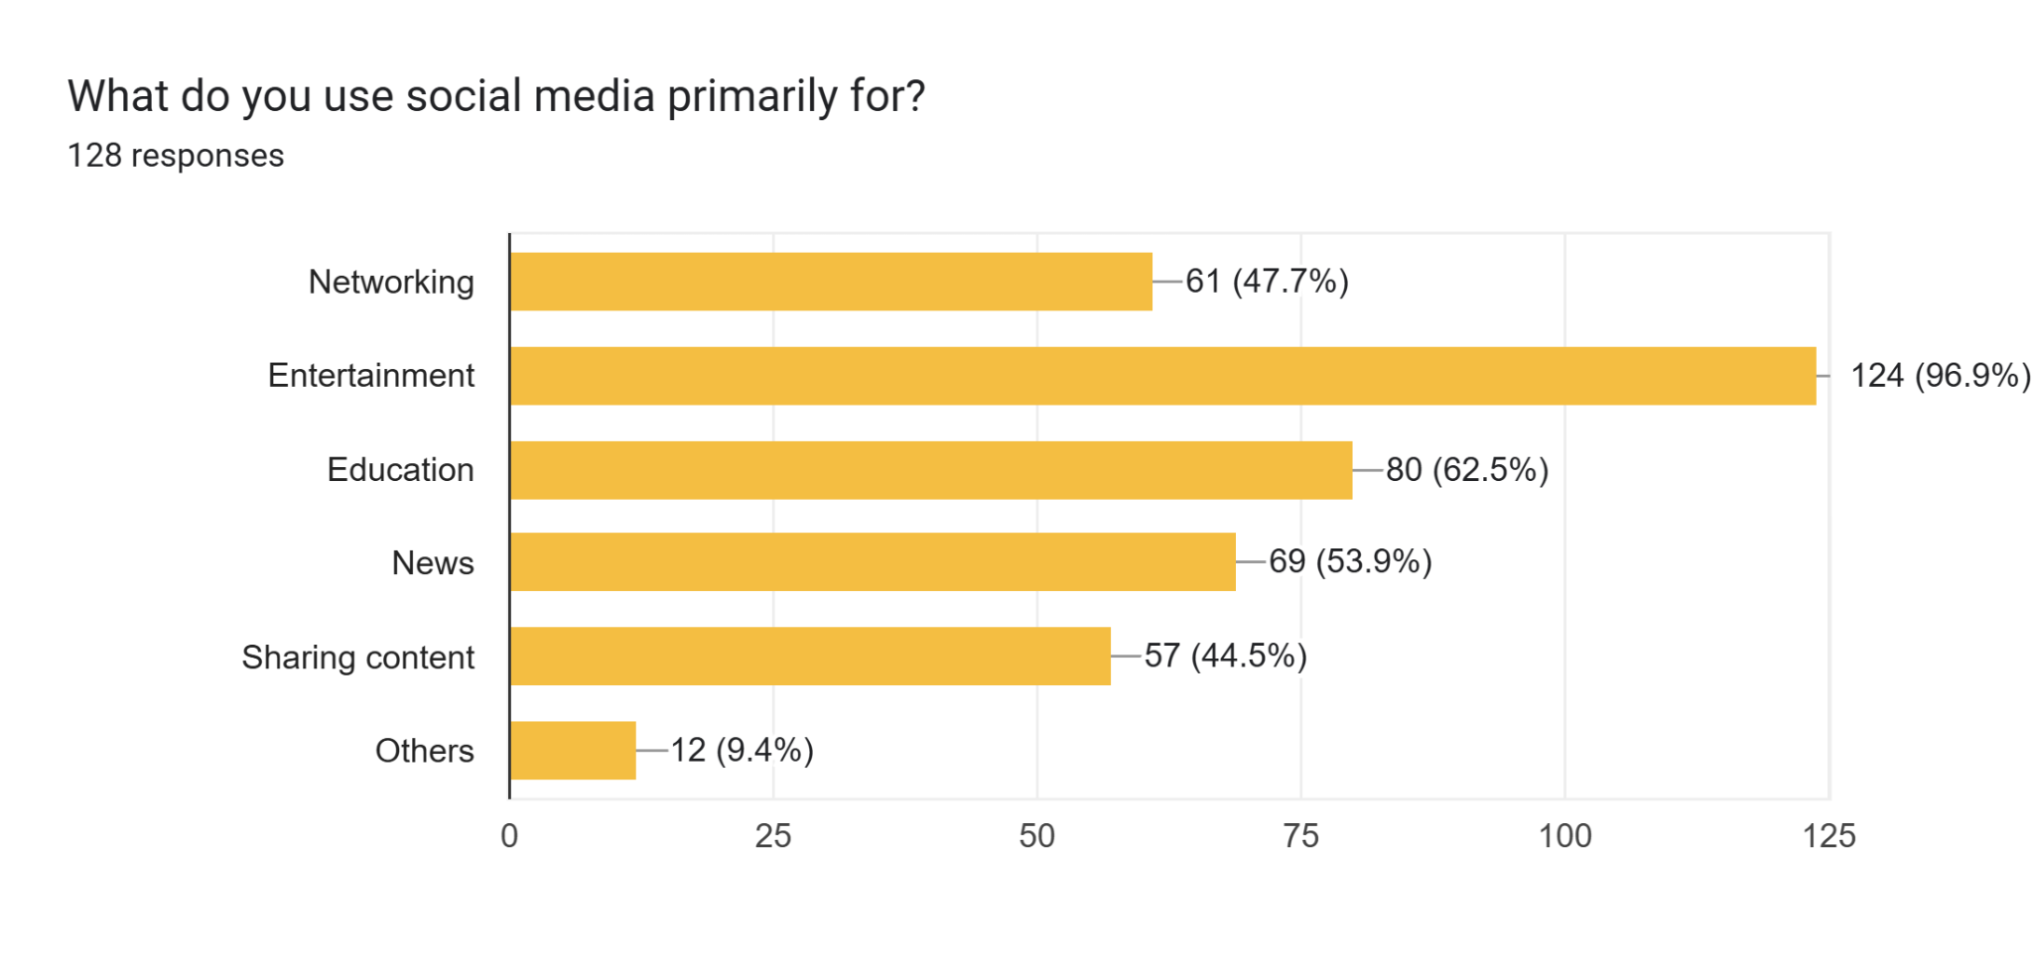
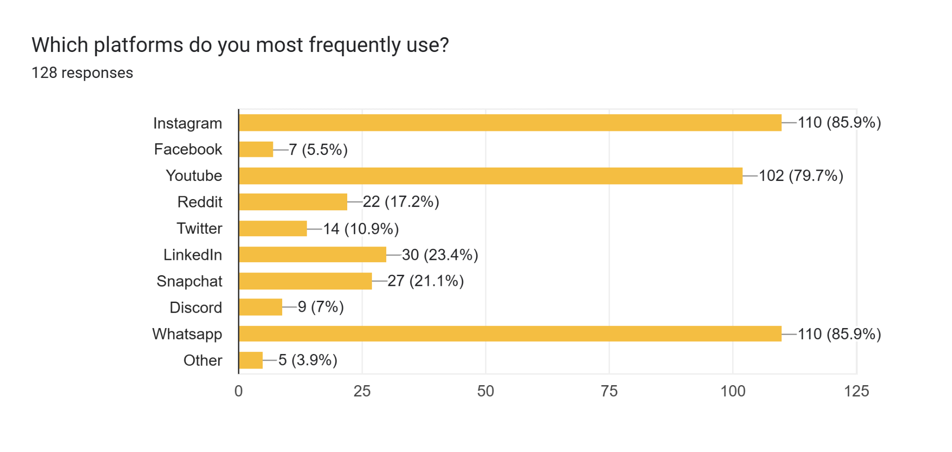
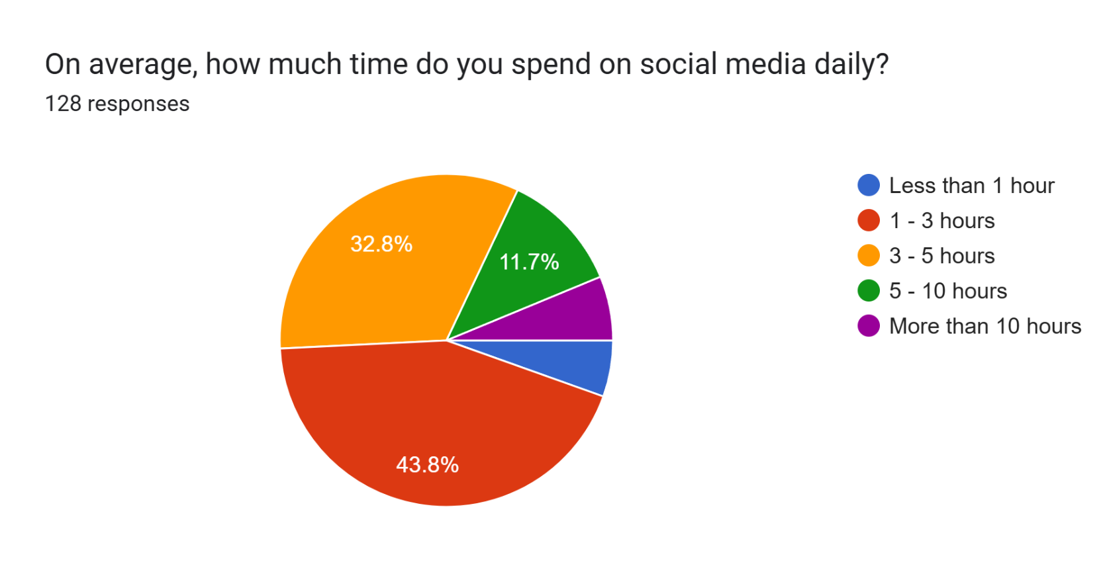
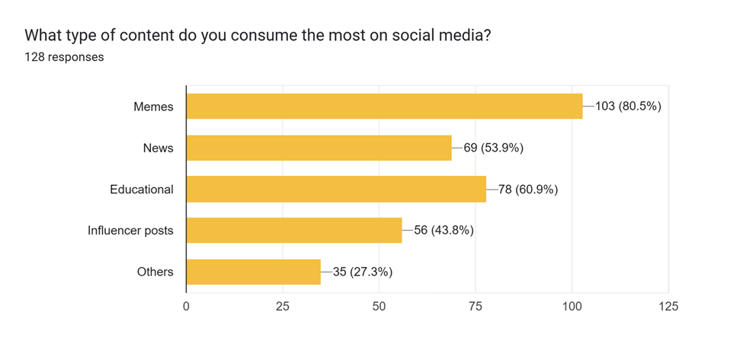

Slide 11
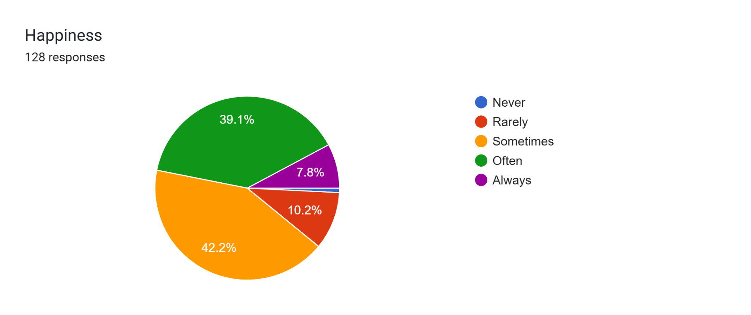
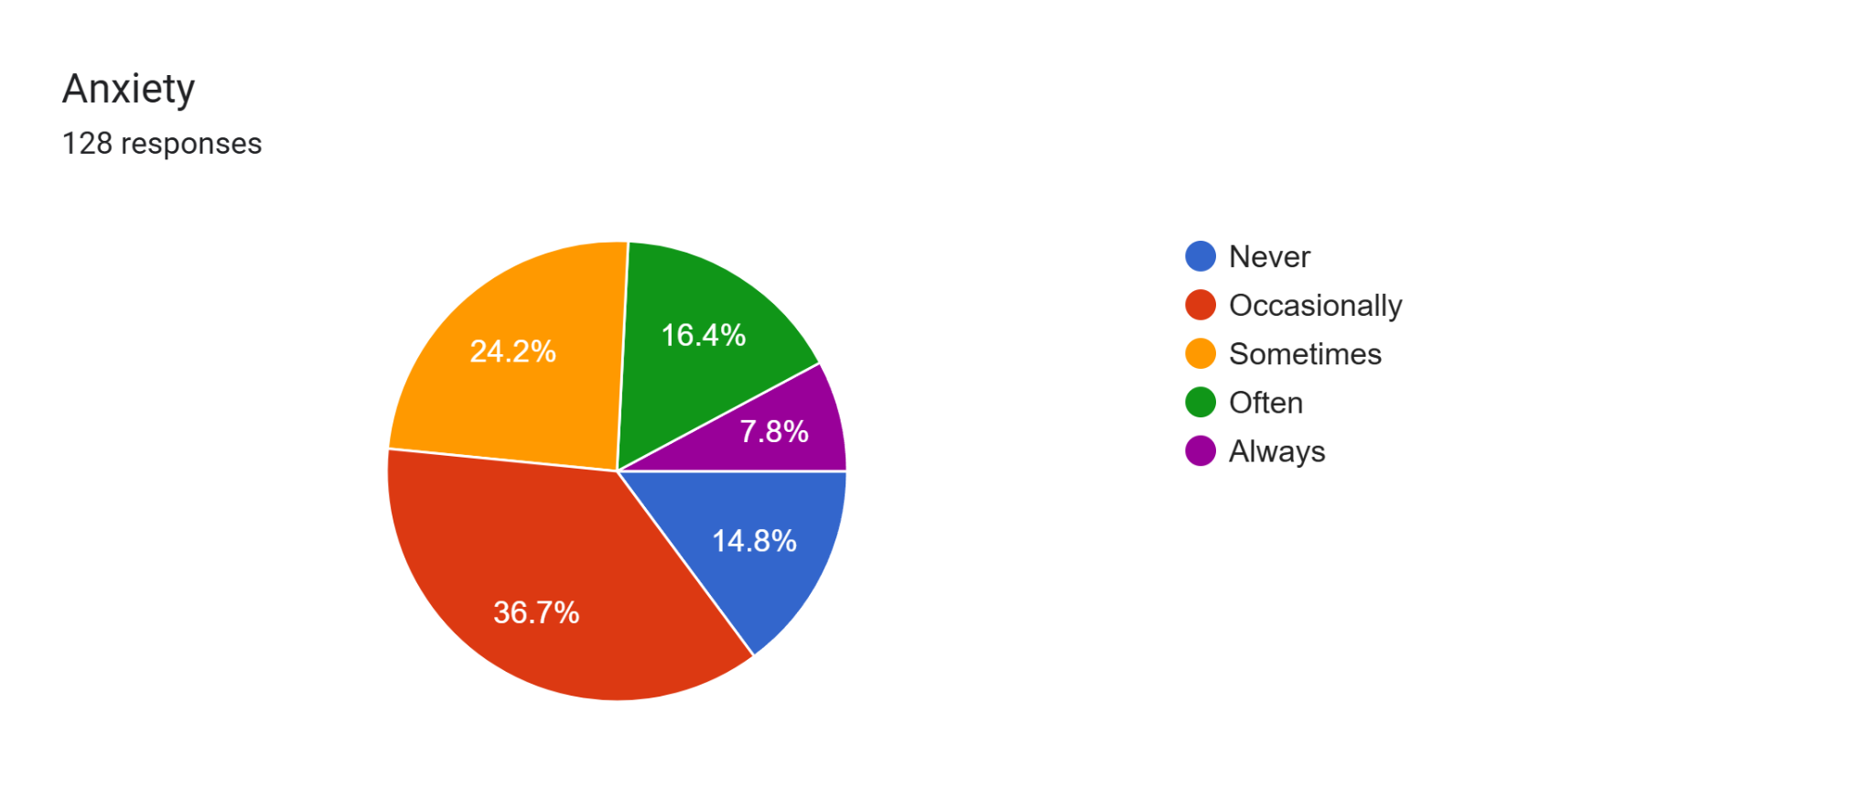
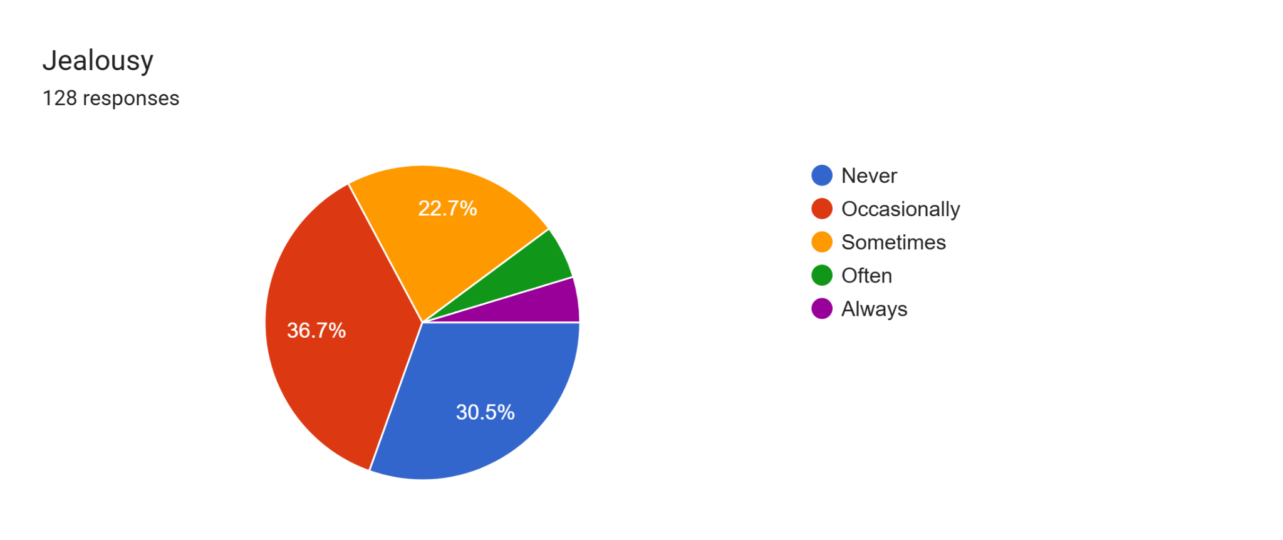
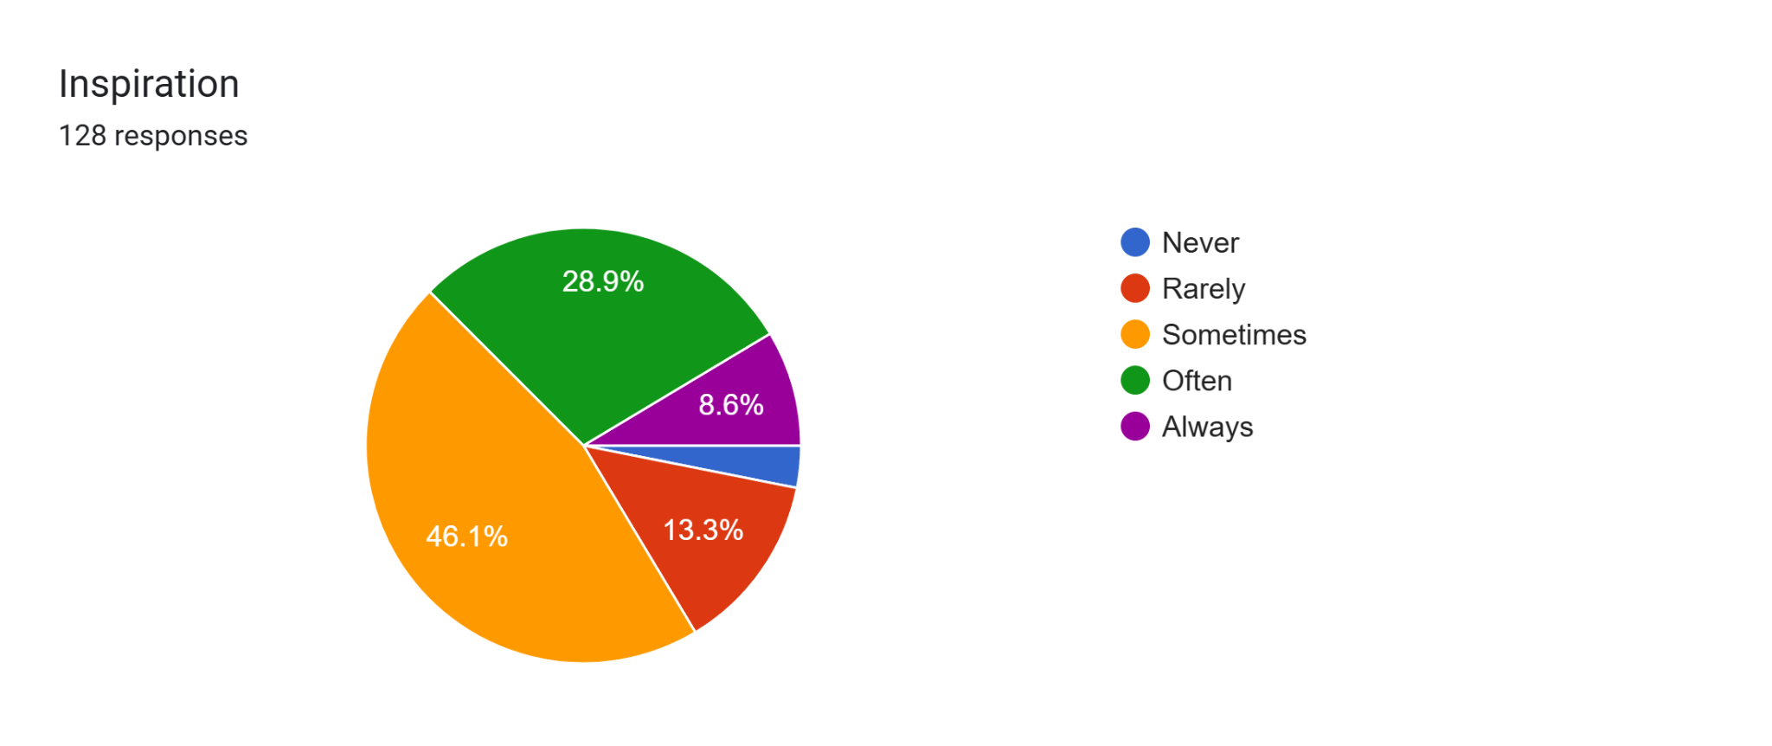
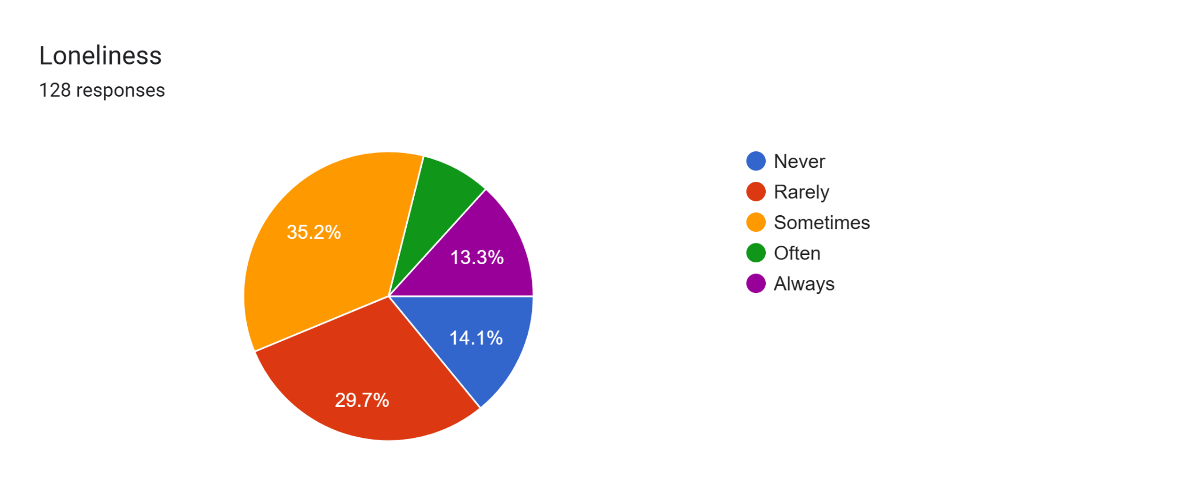
Emotions
Happiness
Anxiety
Jealousy
Loneliness
Inspiration

Slide 12
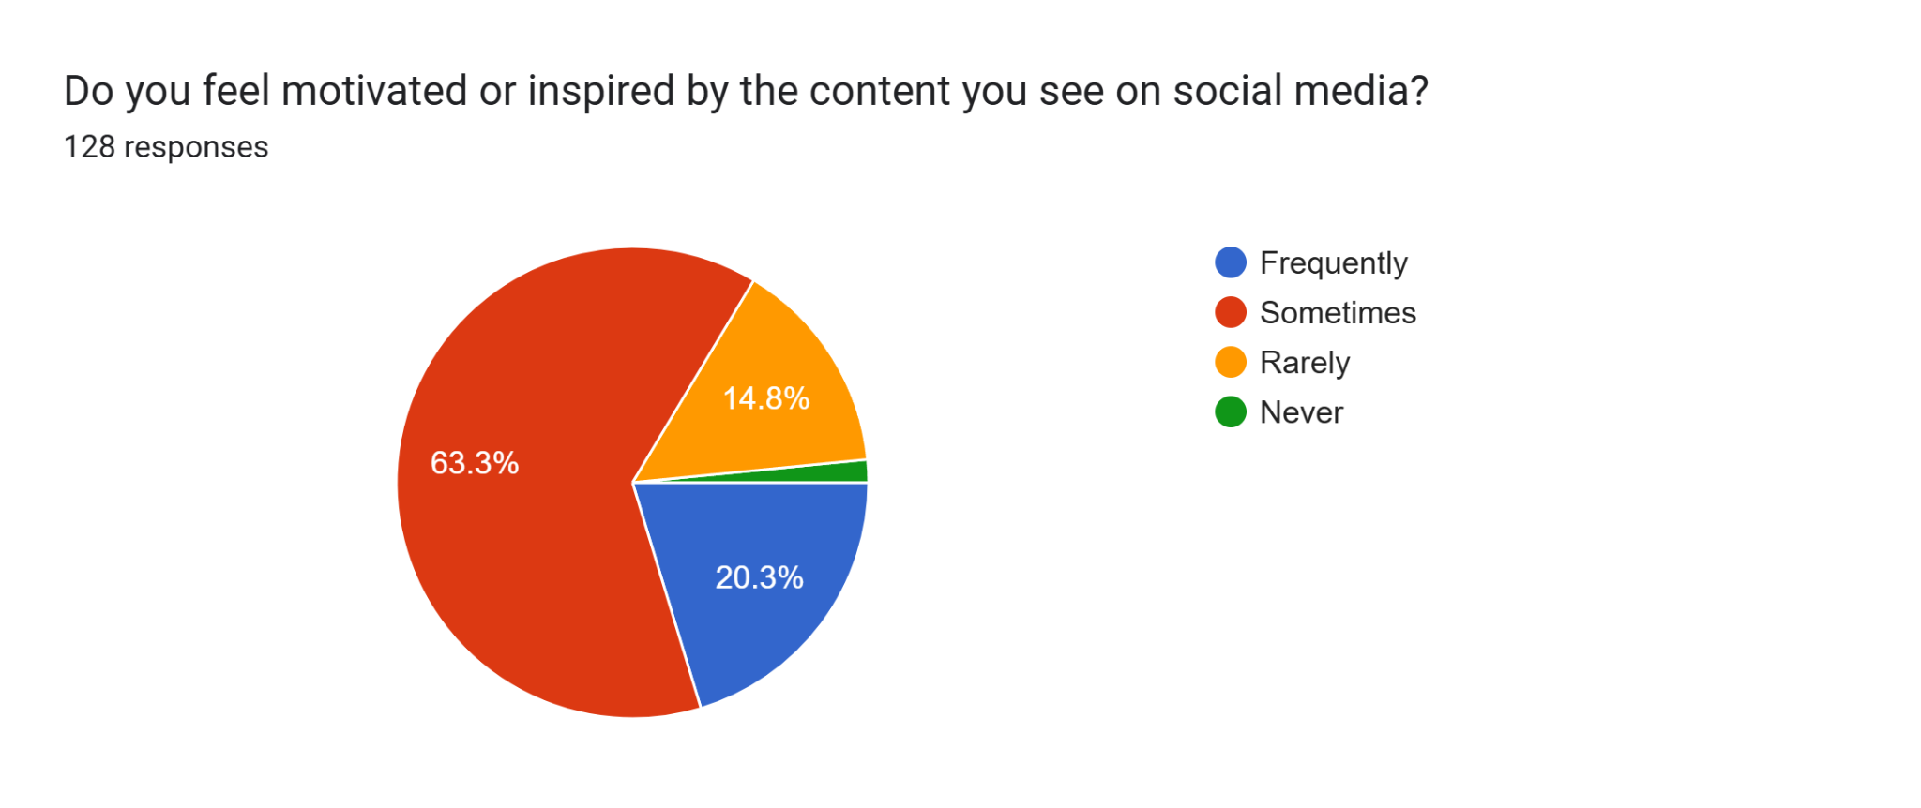
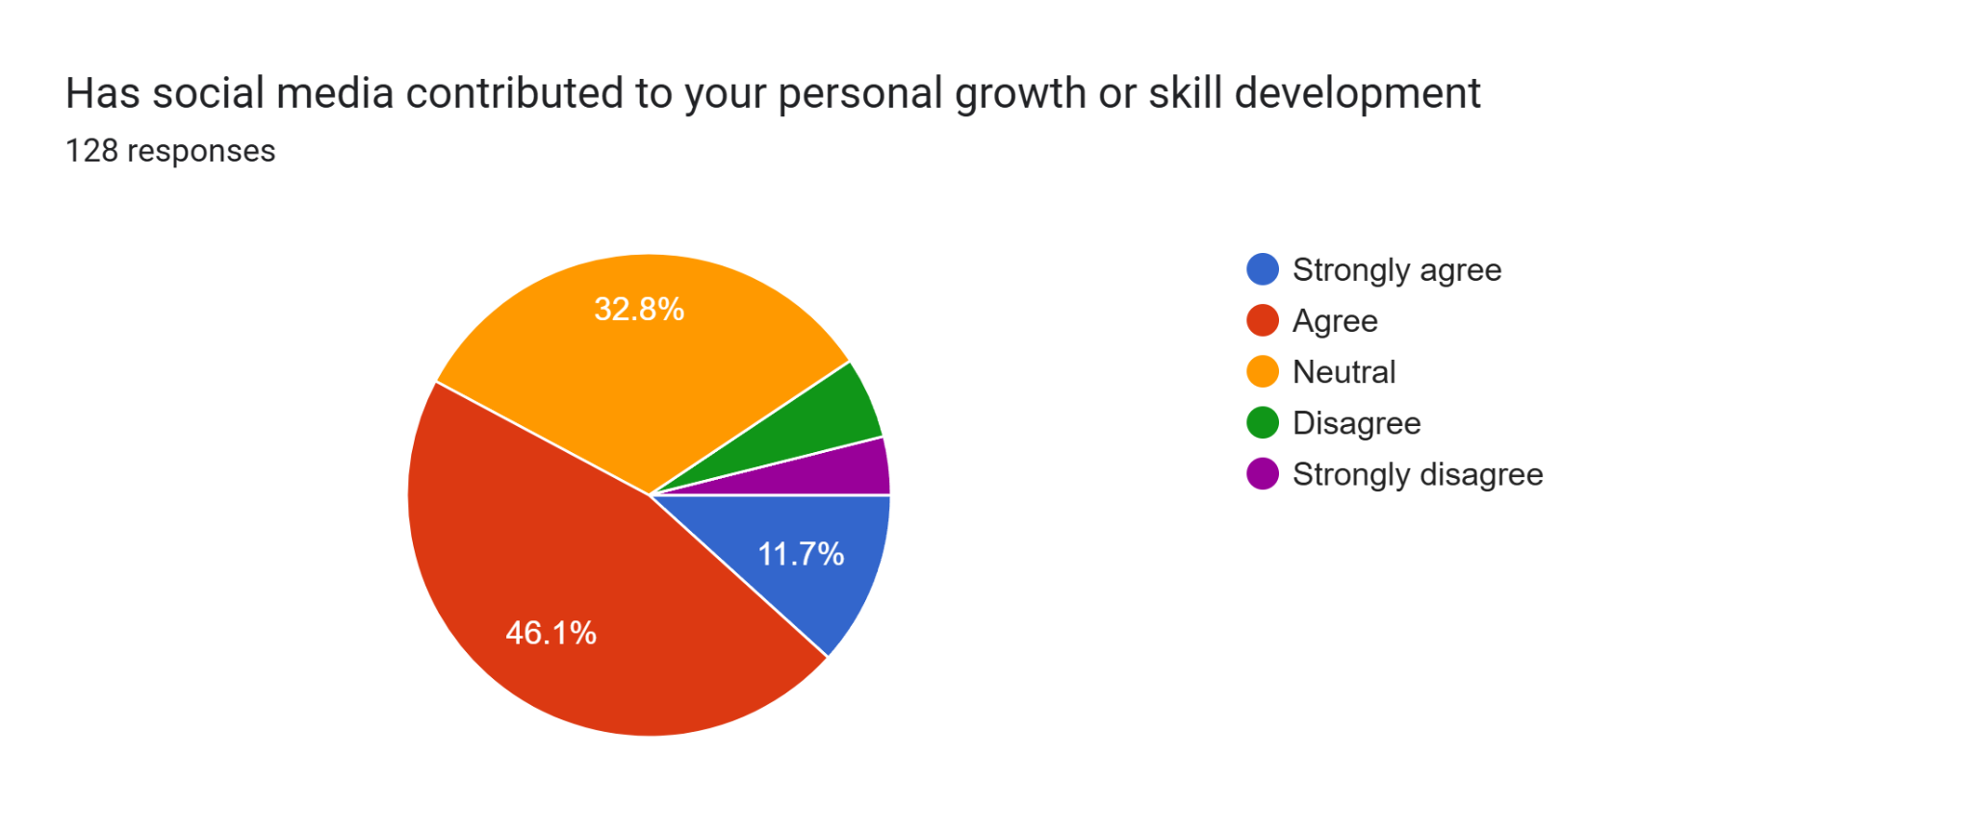
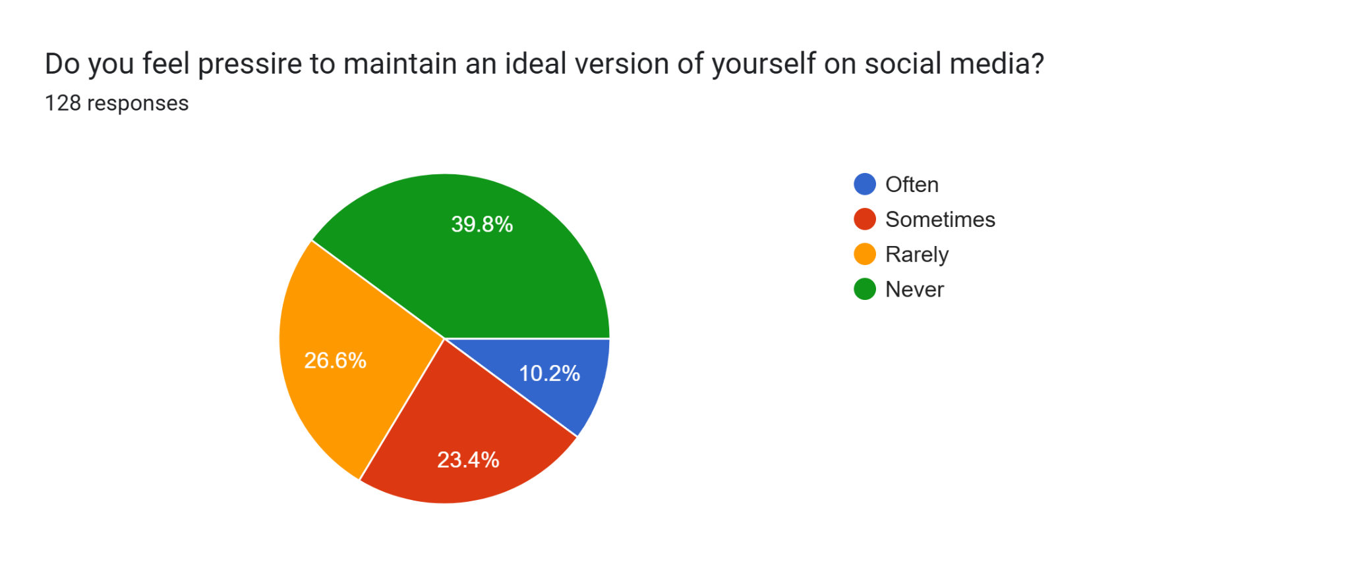
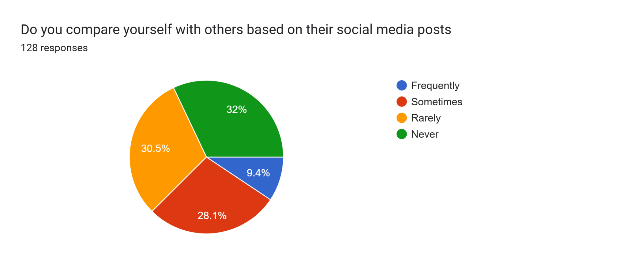
How has Social Media Affected?

Slide 13
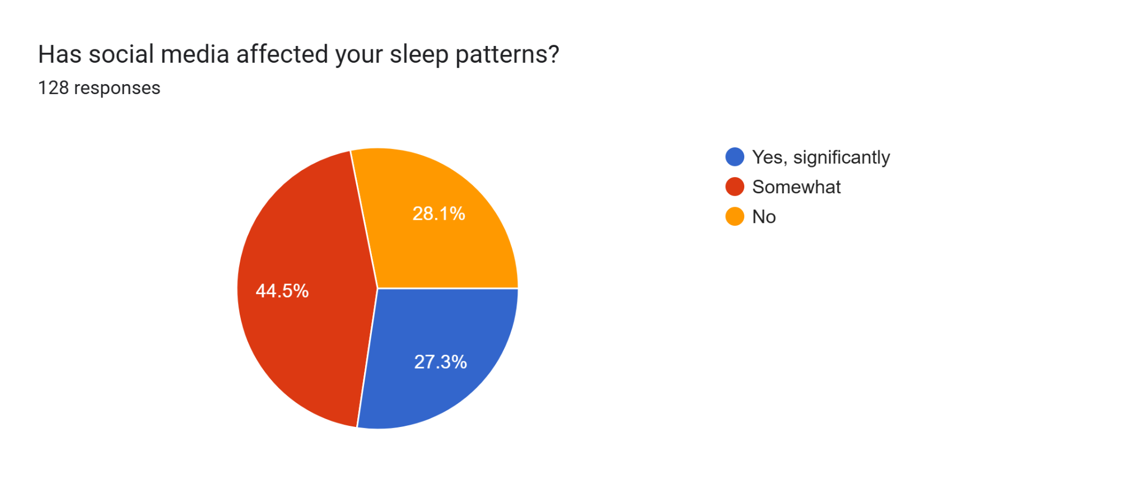
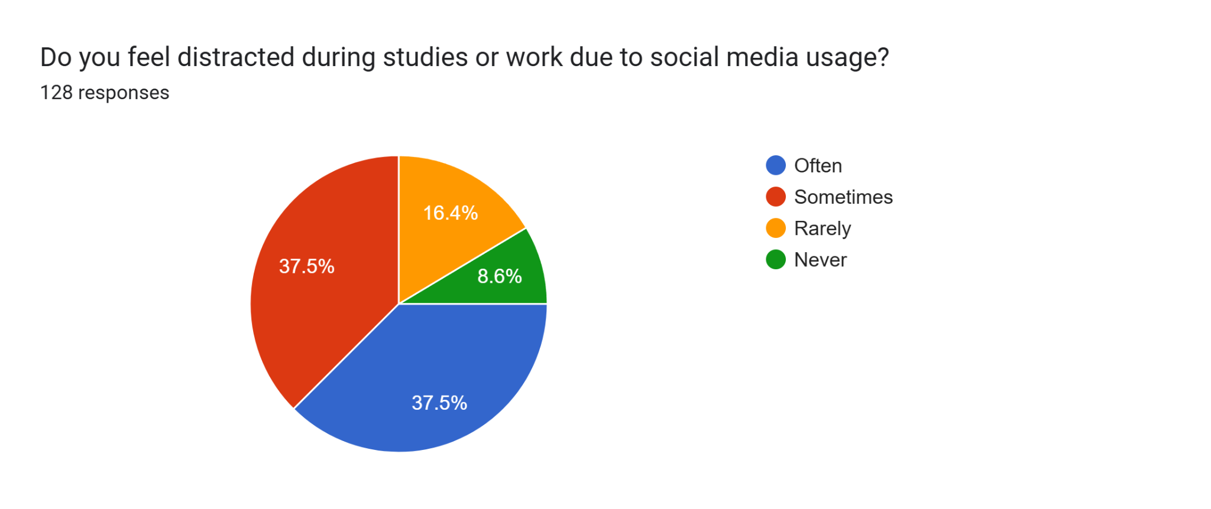
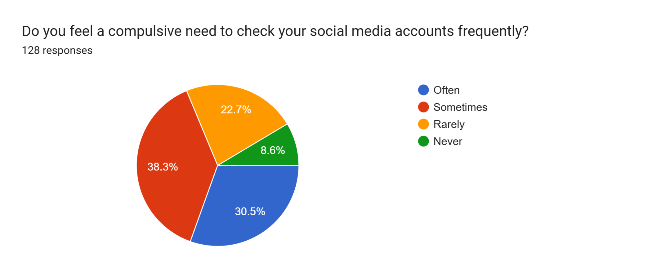
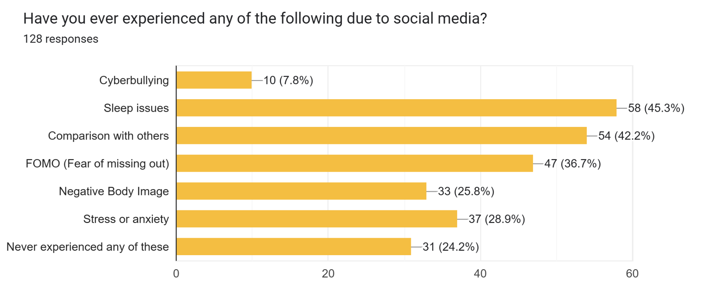
How has Social Media Affected?

Slide 14
Reinforcement Learning to the Rescue
Interacts with the environment and aims to improve users well-being through personalized action recommendations.
Models used: DQN (Deep Q-Network) and A2C (Action to Critic)
Mental Health Score (MHS) was defined: healthier the habits; higher the score.
Interventions are recommended to improve MHS. Interventions that are aligned with real-world psychology and mental health are recommended.
RL Agent
Reward:
Increase in
MHS
Current MHS values
Intervention
Choose
Modified MHS
New State

Slide 15
Overview
MHS Estimation
Maximising MHS
Data from the Survey
Goal
RL Environment
Set-up
State
Action
Categorical
One Hot Encoding
Reward
Multi Valued
Multi label Binarisation
Custom Text
TF-IDF, Word Embedding
DQN
A2C
Suggestions
Pre-processed Data

Slide 16
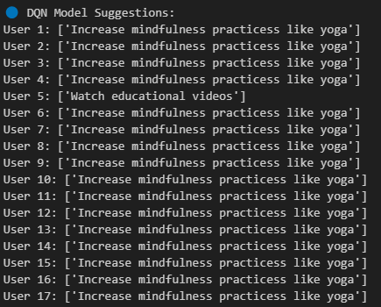
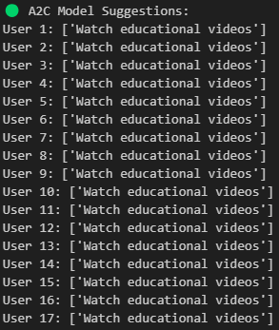
Prototype Results

Slide 17
Conclusion
Social media has a dual impact—while it can be a tool for learning and connectivity, it also has the potential to harm mental health.
Government policies to develop more strict social media laws.
Parental Supervision is a driving factor to control the negative impacts.
An algorithm like discussed would be helpful to monitor and keep track of Mental Health.
Future Directions:
Evaluation with base line models and Parameter tuning.
An organized pipeline for the flow: Raw Data to Suggestions
Deployment

Slide 18
References
https://datareportal.com/social-media-users
https://www.apa.org/topics/social-media-internet/health-advisory-adolescent-social-media-use
https://pmc.ncbi.nlm.nih.gov/articles/PMC10476631/
https://www.researchgate.net/profile/V-Krishna-Priya/publication/340779328_IMPACT_OF_SOCIAL_MEDIA_ON_MENTAL_HEALTH_OF_STUDENTS/links/5e9d856e299bf13079aa9558/IMPACT-OF-SOCIAL-MEDIA-ON-MENTAL-HEALTH-OF-STUDENTS.pdf
https://health.clevelandclinic.org/dangers-of-social-media-for-youth
For images in slide 6 & 7: Napkin AI generator

Slide 19
?
Any Questions….

